Slide 1
Lecture 32
Cache Policies

Slide 2
Recall: Memory Hierarchy
Level | Type
L0 | registers
L1 | i-cache d-cache
L2 | core-unified
L3 | system-unified
L4 | main memory
Access
Capacity
1
1 KB
subset of
backs up
4
4
32 KB
32 KB
subset of
backs up
10
256 KB
subset of
backs up
~ 50
8 MB
subset of
backs up
200
16 GB
subset of
backs up
L5
disk
2 × 10⁶
8 TB
speed
size
Notes:
as speed increases, size decreases
upper level contains a subset of lower level
OR … lower level serves as a backing store for upper level
Notes:
Orally: What sort of things are beyond disk? (Tape, cloud, Internet)
Orally: Why is there a tradeoff between speed and size? Because no one would use a memory that was slower and smaller than another memory.

Slide 3
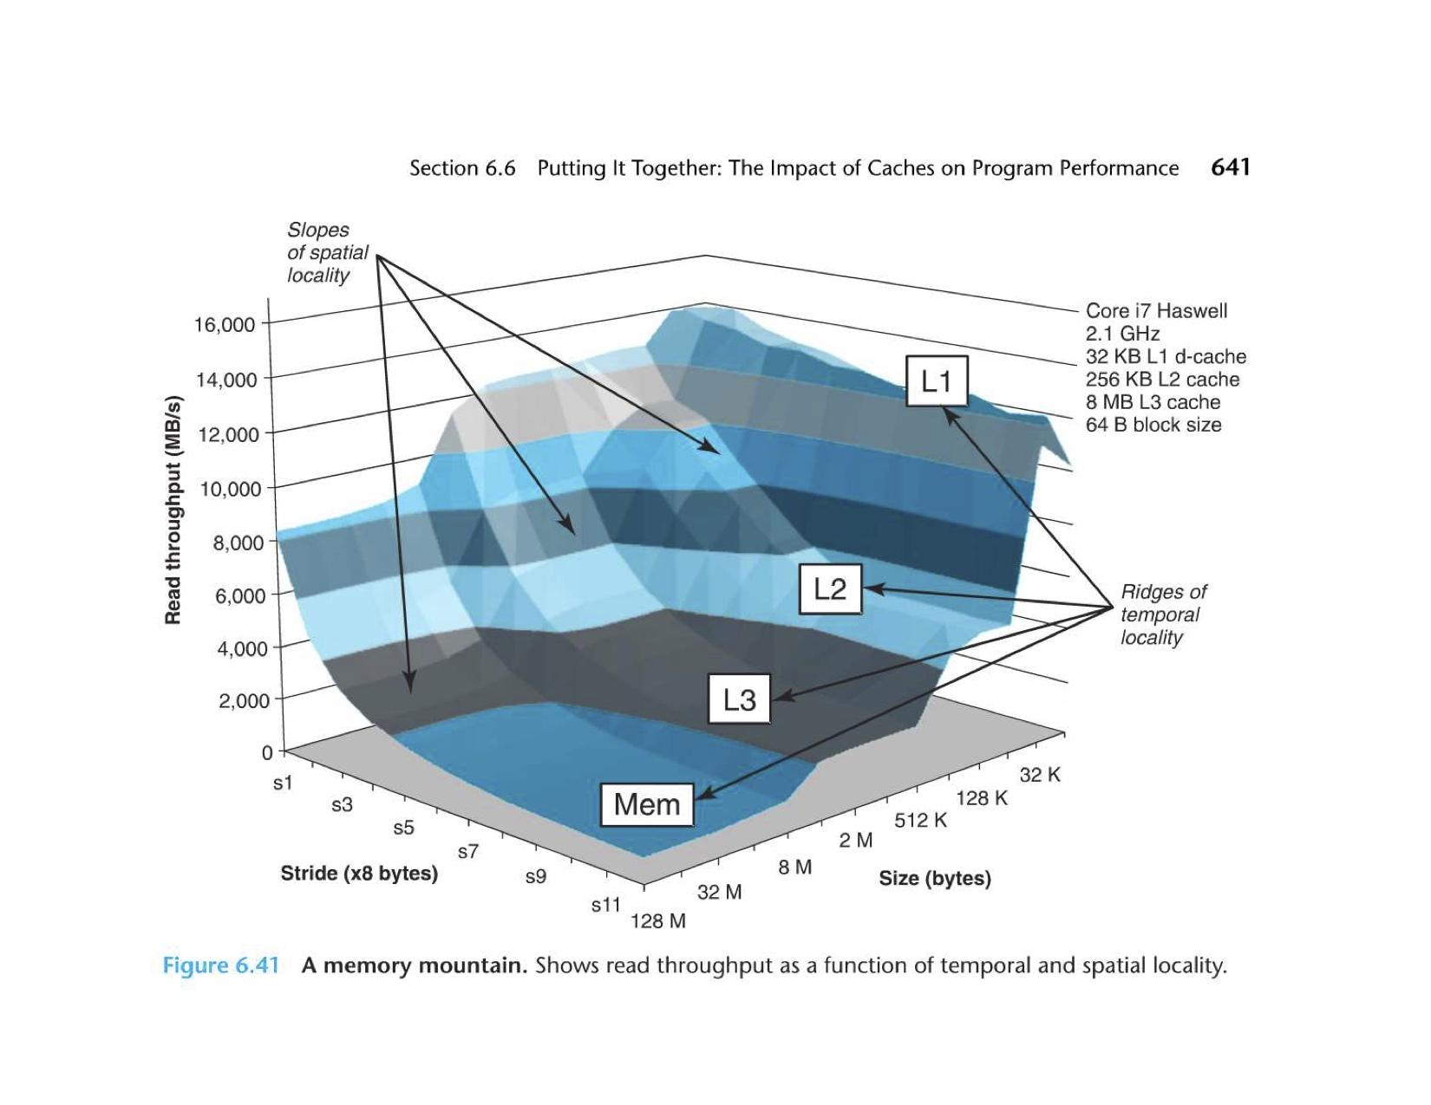

Slide 4
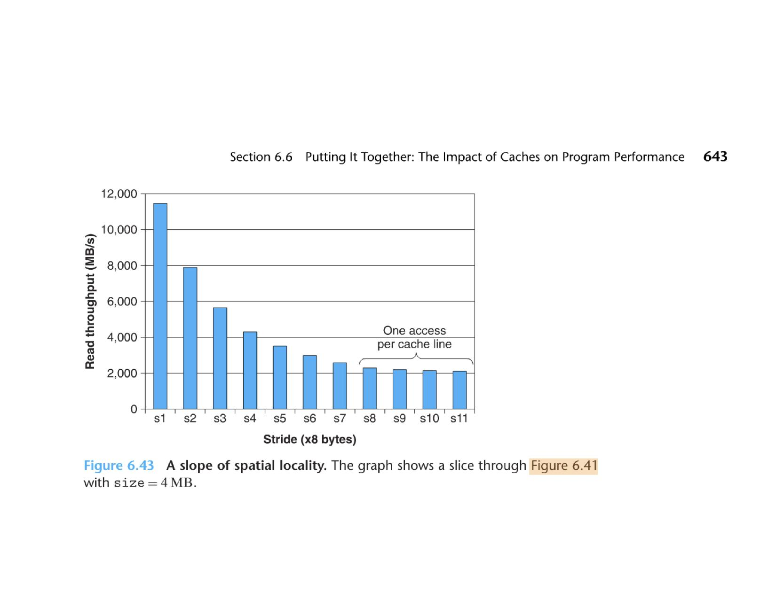
Memory Mountain
as stride increases, throughput decreases
strides of 64+ bytes are same (bad)

Slide 5
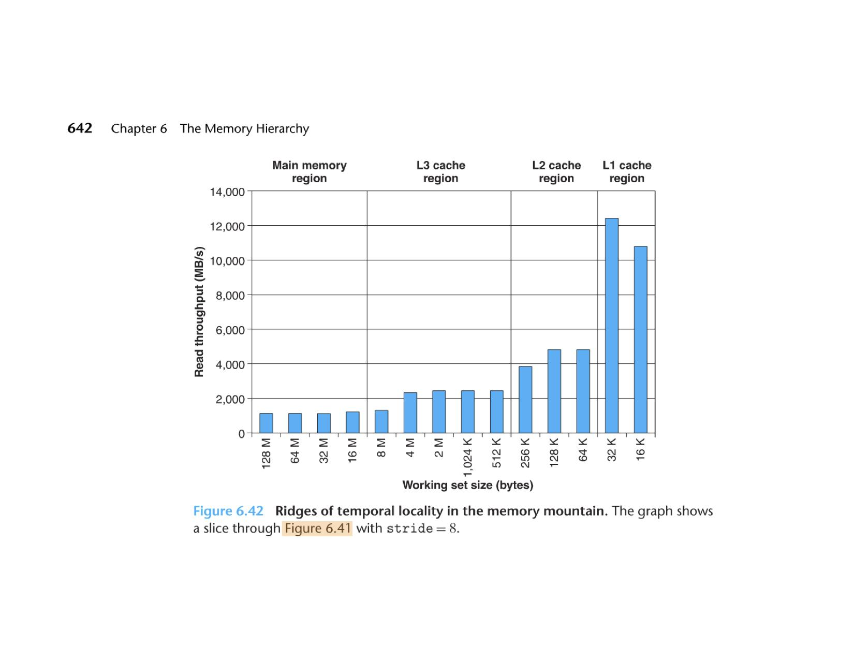
Memory Mountain
as data size increases, throughput decreases
ridges follow cache limits: 32 KB, 256 KB, 8 MB
Notes:
It’s not clear to me why throughput for 32 KB > 16 KB.

Slide 6
Reads vs Writes
Memory writes account for
Read Optimizations
Critical-word-first fetch
on a miss
send to CPU as soon as it arrives
Instruction + data pre-fetching
< 10% of memory accesses
instructions are read only
data access dominated by reads
, request missed word from lower level first
thus CPU may continue while remainder is fetched
predict addresses and load into the cache before a miss occurs
Notes:
Orally: The tech behind pre-fetching is largely an undocumented trade secret.
Orally: Critical-word-first fetch might not be as relevant as it sounds. Because of spatial locality, the next memory reference is likely to be from the same block, most of which is still not loaded.

Slide 7
Read Optimizations
Parallel tag checking + block read
if read is a hit
if read is a miss
Note: Can’t do this on a write
, block passed to CPU immediately
, no benefit but no harm
must match tag before committing to write
writes usually take longer than reads
Writes also more complex due to
data coherency
the consistency of data stored in multiple locations in memory

Slide 8
Data Coherency: Write Hit
x: 20
L1
“dirty”
x: 42
x: 42
E.g., A 4-byte value x, initially 20, is stored at addr 0x63180c of main memory, and also at every level of cache.
Q. What should happen on mov $42, x?
Two policies:
(write hit)
x: 20
L2
x: 42
(red)
write through
information written to cache line, and also the level below
x: 20
L3
write back
information written only to cache line
lower levels are written only when line is evicted
(blue)
x: 42
Of the two, write back is more complex
maintain a
uses less memory bandwidth than write through
data across caches, cores and/or I/O devices
x: 20
Main
Mem
dirty-bit for modified lines
x: 42
not coherent

Slide 9
Data Coherency: Write Miss
x: n/a
L1
x: 20
(write miss)
E.g., What if x is written, but not in the cache?
Two policies:
x: n/a
L2
(blue)
write allocate
load block into every level of the cache
follow by write hit actions
x: 20
x: n/a
L3
(red)
no write allocate
block is modified at the lower level without loading into the cache
x: 20
Can use either write miss policy with either write hit policy, but usually pair:
write allocate with
no write allocate with
x: 20
Main
Mem
write back
write through
x: 42
Of the two, write back is more complex
maintain a
uses less memory bandwidth than write through
data across caches, cores and/or I/O devices

